Slide 1
Augmenting Network Automation with AI: From RAG to MCP
From Retrieval Augmented Generation (RAG) to Model Context Protocol (MCP)
John Capobianco

Slide 2
Overall Agenda
1 hour - Lecture - RAG
1 hour - Labs - RAG
Break - 10:45
30 minutes - Lecture - MCP
1.5 hour - Labs - MCP

Slide 3
RAG Lecture Agenda
Introductions
Tools
Setup for Labs
The Stages of AI
1.0 - GUI / API
1.5 - RAG
2.0 - Agents
Retrieval Augmented Generation
6 Step Process
Embeddings (Vectors)
Storage
Retrieval
RAG-Fusion
Multi-query
Reciprocal Ranking
RAPTOR
Spine-Leaf ?
GraphRAG
Knowledge Graphs
TAG
Tables
RAFT
Fine-Tuning
Agents using RAG​
Agentic RAG
Tool Selection

Slide 4
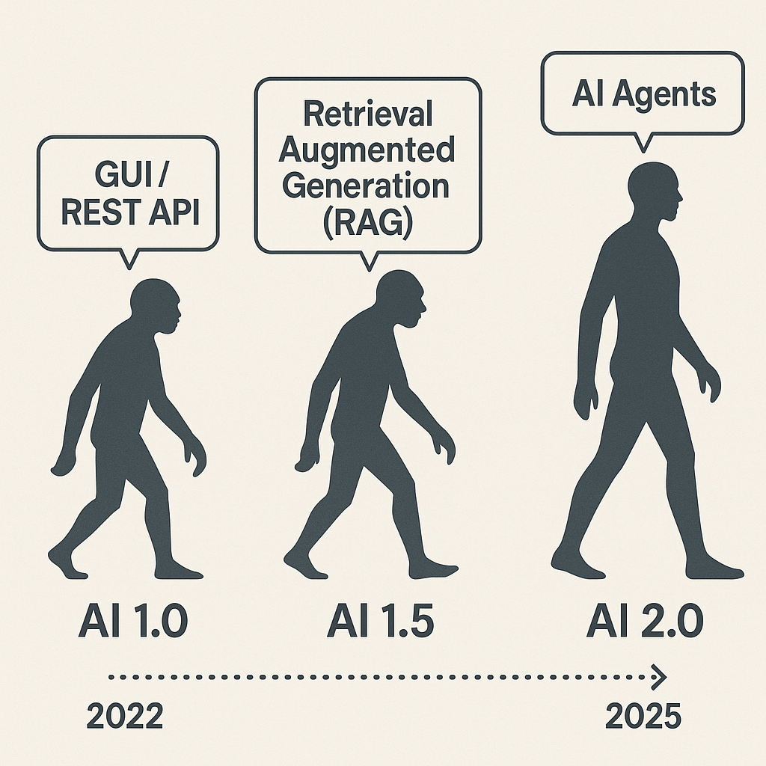

Slide 5
AI 1.0: GUI / REST API
The beginning of modern AI integration into workflows. Interfaces were built around graphical user interfaces (GUI) and REST APIs. Systems were reactive, rule-based, and required precise inputs.
Characteristics:
Manual interactions via UI
Predefined API endpoints
No contextual understanding
Automation limited to basic scripting

Slide 6
AI 1.5: Retrieval Approaches
A leap in capability with large language models able to retrieve and reason over external data. Systems began to offer contextual responses grounded in current or proprietary knowledge.
Characteristics:
Combines LLMs with external data sources
Supports context-aware Q&A
Introduces knowledge grounding
Still linear, not autonomous

Slide 7
AI 2.0: ReACT Agents (AI Agents)
The emergence of autonomous, goal-driven agents capable of planning, reasoning, and taking actions across multiple tools. Systems evolve from stateless prompts to stateful workflows.
Characteristics:
Task orchestration and tool use
Memory and planning
Multi-step reasoning
Autonomous execution across APIs, files, and platforms

Slide 8
6 Steps of Retrieval Augmented Generation

Slide 9
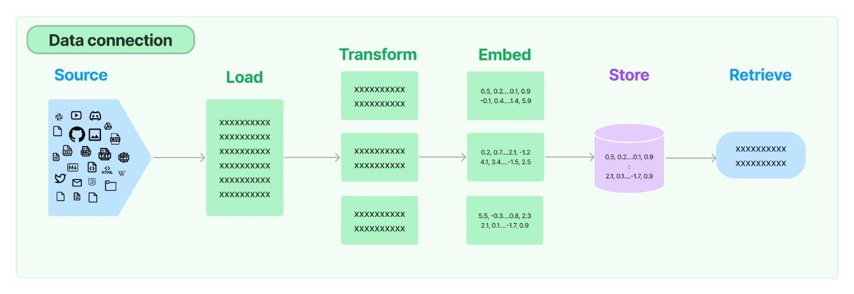

Slide 10
1 - Source
The source of the external knowledge you want to augment the generation of output.
High level categories:
Webpages
PDFs
Cloud Providers
Social Platforms
Messaging Services
Productivity Tools
Common File Types
CSV
Directory of files
Unstructured files
JSON
HTML

Slide 11
2 - Load
Once you have a source you need to find the appropriate loader
Sample code to load a JSON file:
from langchain_community.document_loaders import JSONLoader
file_path='./sample.json'
loader = JSONLoader( file_path=file_path, jq_schema='.quiz', text_content=False)
docs = loader.load() print(docs[0].page_content[:100]) print(docs[0].metadata)
For all loaders: ​ Document loaders | 🦜️🔗 LangChain​
document_loaders — 🦜🔗 LangChain documentation

Slide 12
3 - Split (Transform)
A semantic splitter breaks text into chunks based on meaning, not just size or structure. It uses LLMs or embeddings to find natural boundaries—like a shift in topic, tone, or idea—rather than blindly splitting by paragraphs, headers, or token limits.
📘 Example: Network Engineering Manual
Imagine you're using RAG on a 50-page Cisco IOS XE config guide.
Naive splitter: Splits every 500 tokens. This might:
Split a show ip interface brief explanation halfway.
Mix unrelated topics like BGP and EIGRP in the same chunk.
Semantic splitter: Analyzes where the concept changes and chunks accordingly:
One chunk for show ip interface brief
Another for configure static routing
Another for EIGRP authentication
This ensures each chunk is coherent, self-contained, and relevant to a single question.

Slide 13
3 - Split (Transform)
A note on splitting - we are entering a bit of a recursive inception like dependency on Artificial Intelligence models being used to improve the outcomes from further models downstream
To wit; an embeddings model is used to semantically chunk the data that is then transformed with an embeddings model into vectors (embeddings) (next step) and then a large language model can perform semantic lookups from the user prompt against the vectors (embeddings) (to be explained later)
Idea being its turtles all the way down .. use AI to help AI outcomes

Slide 14
4 - Embed
Embedding models transform human language into a format that machines can understand and compare with speed and accuracy. These models take text as input and produce a fixed-length array of numbers, a numerical fingerprint of the text's semantic meaning. Embeddings allow search system to find relevant documents not just based on keyword matches, but on semantic understanding.
Input: "How do I configure BGP authentication?"
Output: [0.12, -0.87, 0.45, ..., 0.33] ← fixed-length vector
Similar vectors → semantically similar content

Slide 15
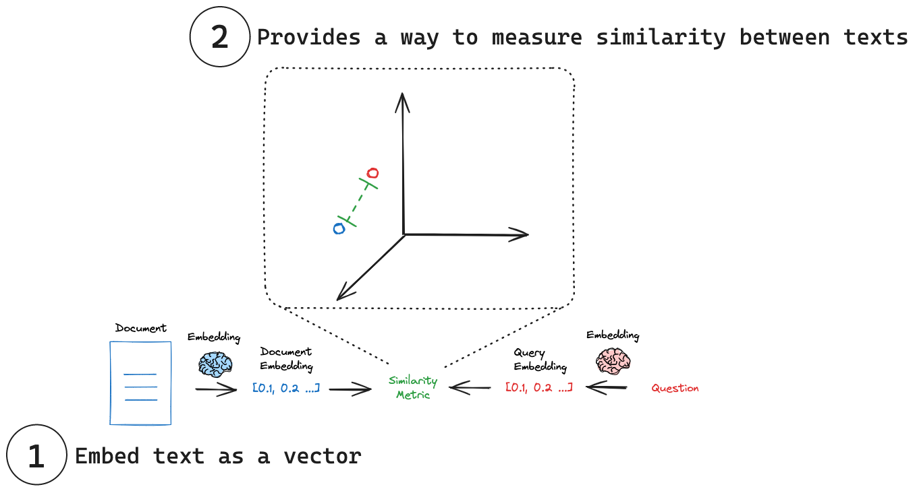
Embedding models | 🦜️🔗 LangChain

Slide 16
5 - Store
Now that we have lists of floating point numbers, the vectors, we need to store them either in memory or in a database (or both). This database is optimized for storing and searching embeddings (numerical vectors). Enabling fast similarity search to retrieve relevant documents based on semantic meaning.
ChromaDB, FAISS, Weaviate, Pinecone, Elastic, Qdrant, Milvus
We will be using ChromDB, locally, privately, for our labs
I also really like Elastic because you get the “ELK” (Elastic, Logstash, Kibana) stack - meaning you can visualize and inspect much easier

Slide 17
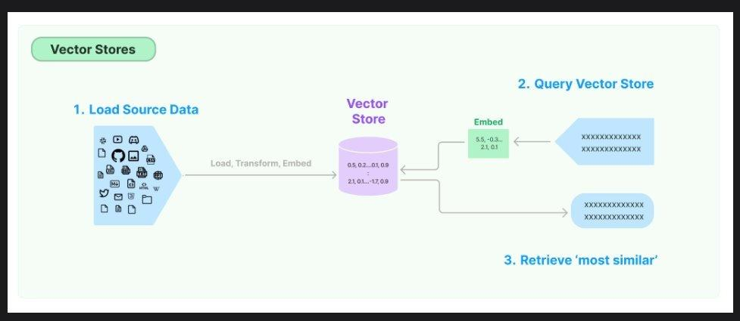
6 - Retrieve
Finally the Large Language Model (LLM) gets involved in the process and the prompt is transformed into vectors and a similarity search is performed between the prompt and the vector store returning the closest vectors to augment the generation of output.

Slide 18
6 - Retrieve
Finally the Large Language Model (LLM) gets involved in the process and the prompt is transformed into vectors and a similarity search is performed between the prompt and the vector store returning the closest vectors to augment the generation of output.

Slide 19
Questions?

Slide 20
RAG: Multi-query

Slide 21
People ask stupid questions!
Can we take the users original question and derive +n number of similar questions
Similar or different in:
Tone
Sentiment
Word selection
Sophistication
Technical accuracy
We can use AI to generate additional, similar, prompts to help AI generate the best possible answer to the original prompt

Slide 22
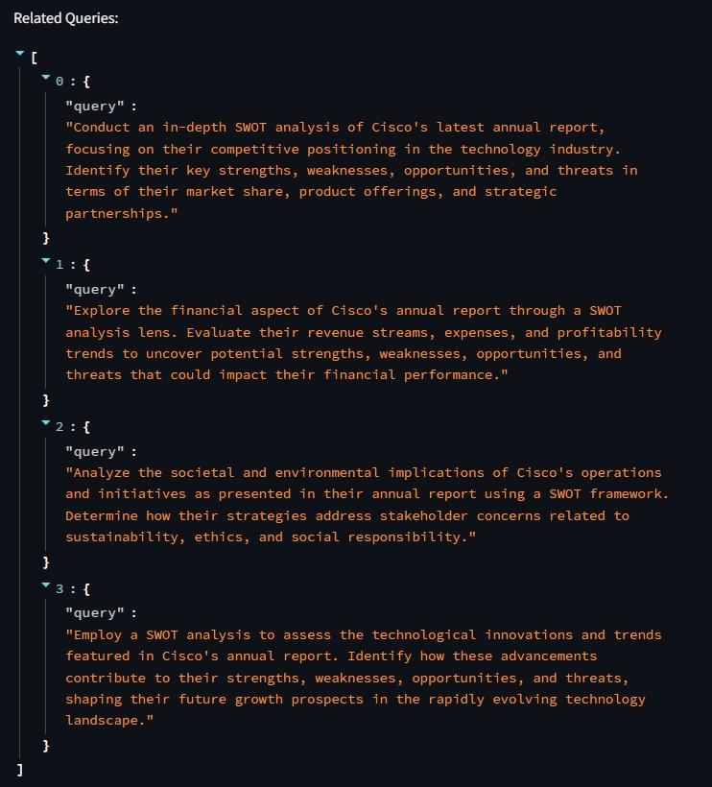


Slide 23
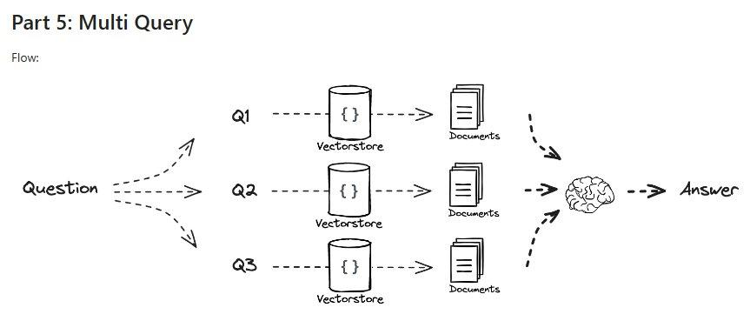
Multi-query: Augment the prompt
rag-from-scratch/rag_from_scratch_5_to_9.ipynb at main · langchain-ai/rag-from-scratch · GitHub

Slide 24
RAG: Fusion

Slide 25
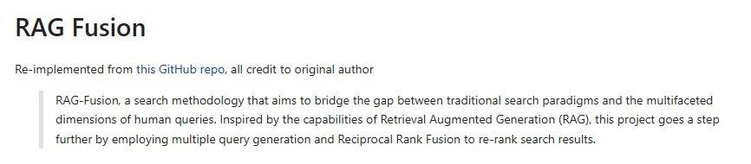
Reciprocal Re-Ranking
langchain/cookbook/rag_fusion.ipynb at master · langchain-ai/langchain · GitHub​

Slide 26
Synthetic Answers
Going a step further we can use reciprocal ranking and other methods to evaluate and rank the 'best' answers
We can take 'all' answers and synthesize a 'best' answer
We can round-robin against multi-LLM to get different 'perspectives' and generations; and synthesize a multi-LLM council of answers
We can bounce the initial answers from all LLMs against all other LLMs and come to a consensus of the 'best' answer (and throw away outlying hallucinations

Slide 27
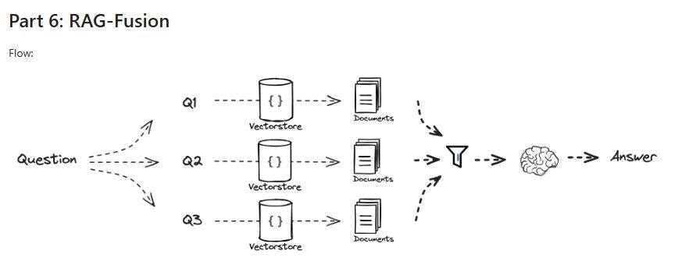
rag-from-scratch/rag_from_scratch_5_to_9.ipynb at main · langchain-ai/rag-from-scratch · GitHub

Slide 28
RAPTOR: Recursive Abstractive Processing for Tree-Organized Retrieval

Slide 29
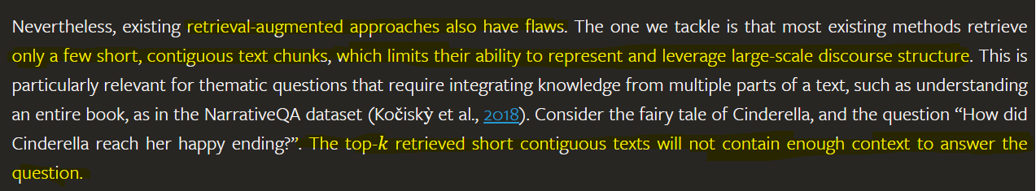
The drawbacks of RAG:
RAPTOR: Recursive Abstractive Processing for Tree-Organized Retrieval (arxiv.org)

Slide 30
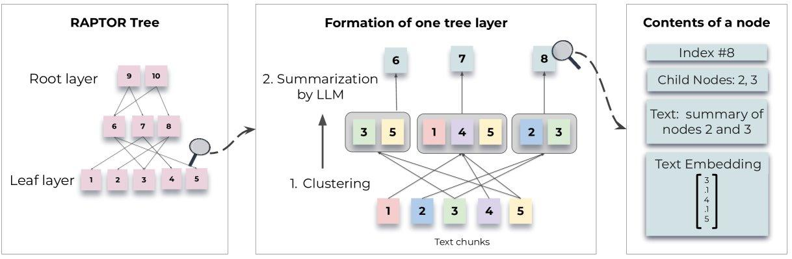
Look familiar?
RAPTOR: Recursive Abstractive Processing for Tree-Organized Retrieval (arxiv.org)

Slide 31
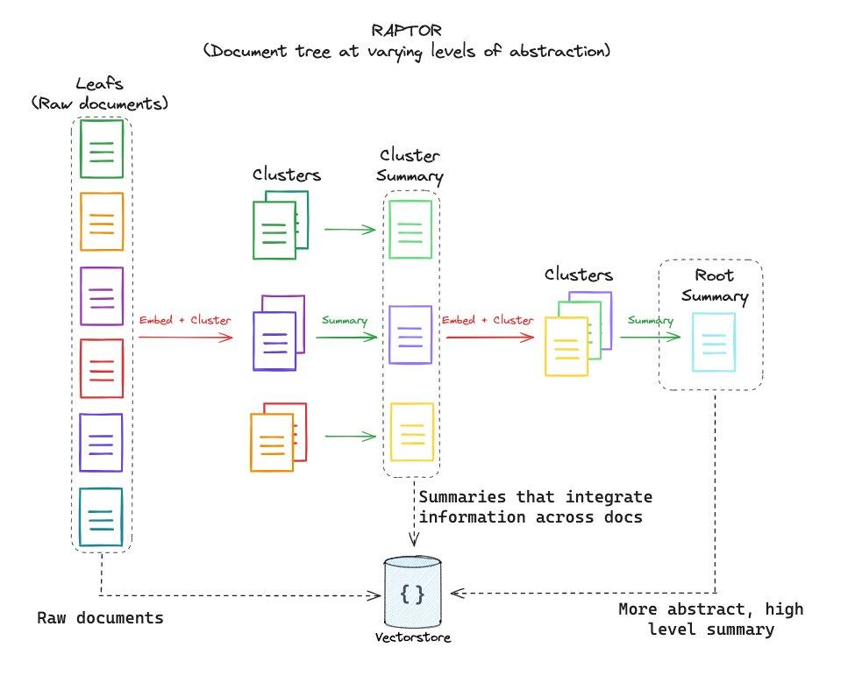

Slide 32
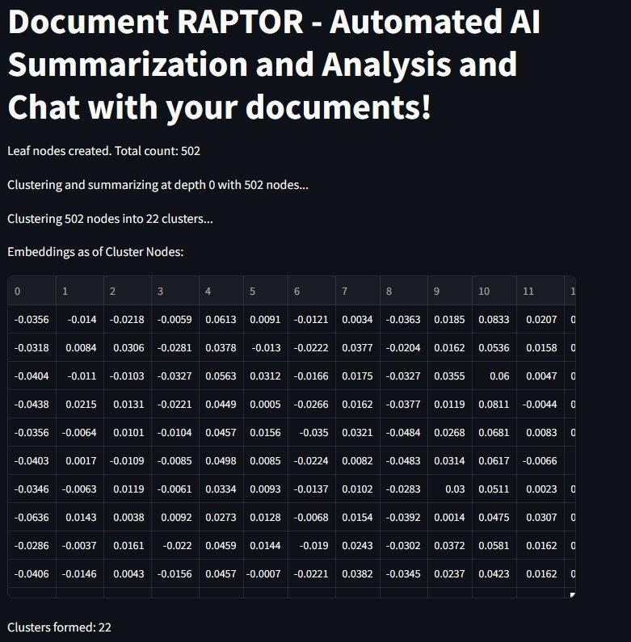
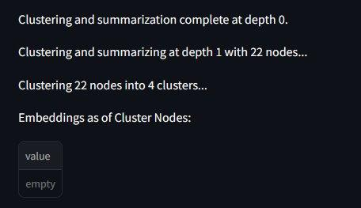
5
LEAF NODES
22 SPINES
4 SPINES
ROOT

Slide 33
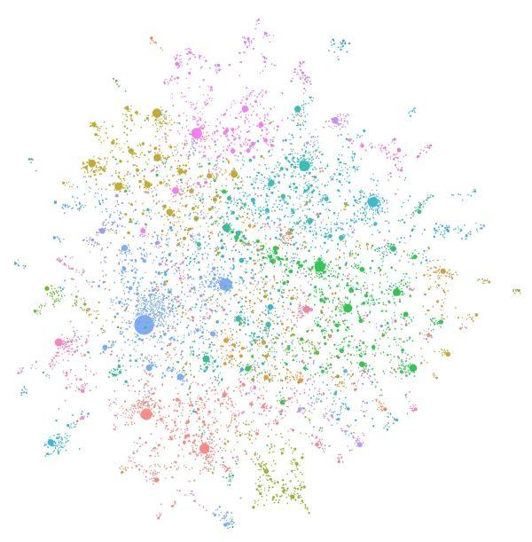
graphRAG

Slide 34
Knowledge Graphs
Baseline RAG struggles to connect the dots. This happens when answering a question requires traversing disparate pieces of information through their shared attributes in order to provide new synthesized insights.
Baseline RAG performs poorly when being asked to holistically understand summarized semantic concepts over large data collections or even singular large documents.
The LLM processes the entire private dataset, creating references to all entities and relationships within the source data, which are then used to create an LLM-generated knowledge graph.
This graph is then used to create a bottom-up clustering that organizes the data hierarchically into semantic clusters (indicated by using color in Figure 3 below). This partitioning allows for pre-summarization of semantic concepts and themes, which aids in holistic understanding of the dataset.
At query time, both of these structures are used to provide materials for the LLM context window when answering a question.
GraphRAG: Unlocking LLM discovery on narrative private data - Microsoft Research

Slide 35
5
** WARNING **

Slide 36
graphRAG is *very* expensive
As you can imagine these graphs are huge and require a lot of computational and GPU power.
I abandoned my first attempt at GraphRAG after the job / bill reached about $65 – and it wasn't even close to being finished
Local models (LLMs) via tools like Ollama can ease the costs but they will still take substantial amount of time to generate locally unless you have serious GPU access
Be careful with cloud models when trying to build Knowledge Graphs

Slide 37
TAG: Table Augmented Retrieval

Slide 38
Beyond Text2SQL
Tabular data is already organized; structured; and can be queried with Structured Query Language (SQL)
Attempts to move to Text2SQL still cumbersome
LLM and a similar approach as RAG lets up lookup Tabular data in a similar way

Slide 39
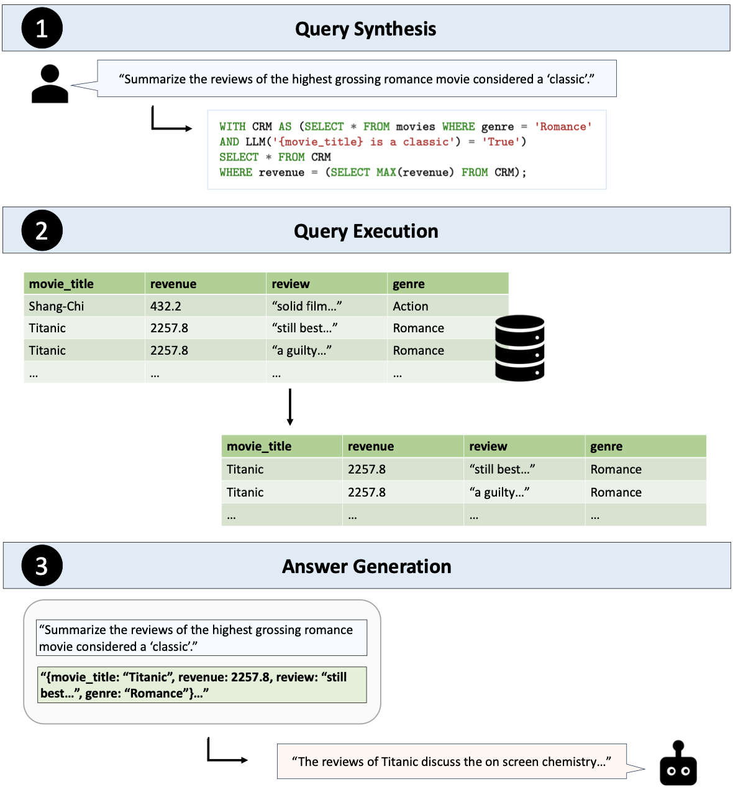
[2408.14717] Text2SQL is Not Enough: Unifying AI and Databases with TAG

Slide 40
RAFT: Retrieval Augmented Fine-Tuning

Slide 41
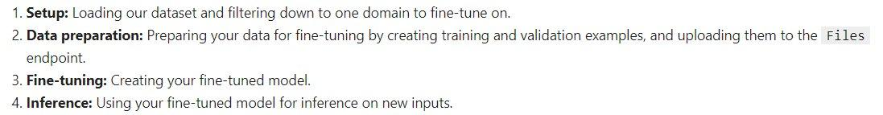
Fine-Tuning: We can teach models
Fine-tuning is the process of taking a pre-trained machine learning model and further training it on a smaller, targeted, domain-specific, data set. The aim of fine-tuning is to maintain the original capabilities of a pretrained model while adapting it to suit more specialized use cases.
https://github.com/openai/openai-cookbook/blob/main/examples/How_to_finetune_chat_models.ipynb

Slide 42
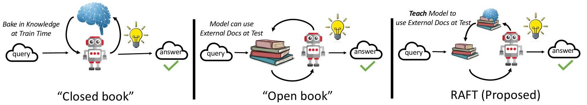
We can, recursively, use RAG to Fine Tune
RAFT: Adapting Language Model to Domain Specific RAG (arxiv.org)
RAFT (Retrieval Augmented Fine-tuning): A new way to teach LLMs (Large Language Models) to be better at RAG (Retrieval Augmented Generation) (microsoft.com)

Slide 43
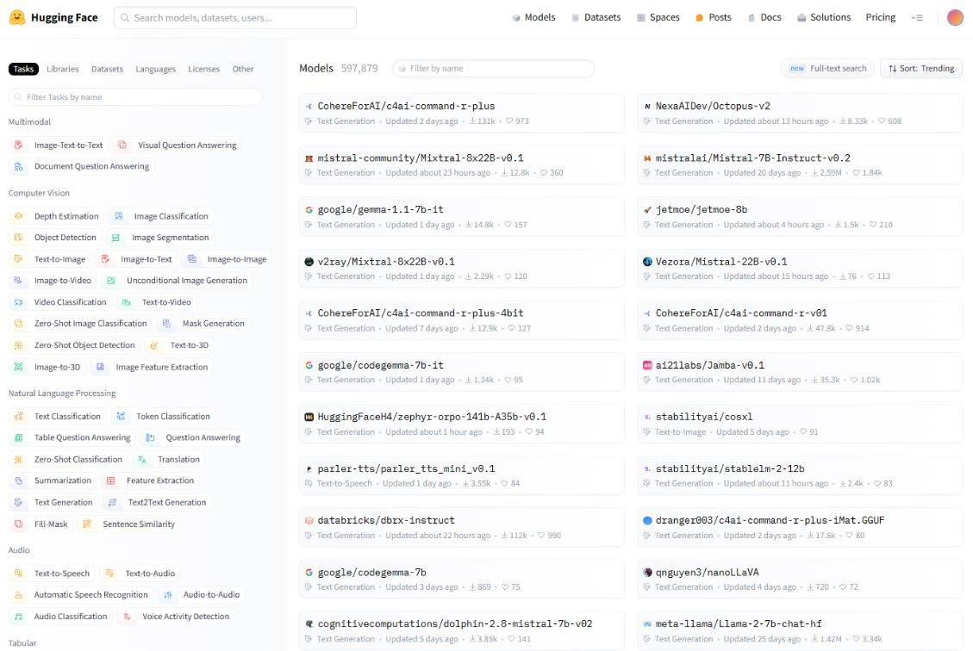
HuggingFace: A GitHub-like repo for open source model

Slide 44
AI Agents: Using RAG

Slide 45
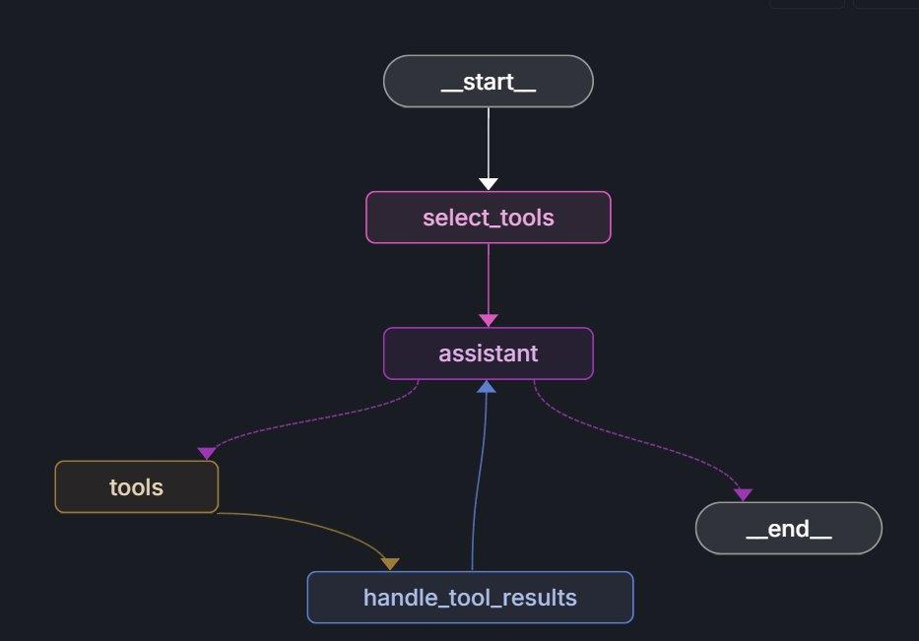
RAG

Slide 46
Questions?

Slide 47
Resources
Buddies (Basic RAG) – Document, Packet
automateyournetwork/Document_Buddy: Chat with various documents - XLSX, DOCX, PPTX, CSV, PDF, TXT - using chatGPT 4 Turbo and Langchain
automateyournetwork/packet_buddy: pcap analysis provided by chatGPT4 Turbo
RAPTORs – Document, Packet automateyournetwork/Document_RAPTOR: A RAPTOR Tree of your documents used for Language Model Retrieval to chat with the documents!
automateyournetwork/packet_raptor: An AI Assistant using RAPTOR to talk to .pcaps
Knowledge Graphs (GraphRAG) - Document, Packet
automateyournetwork/Document_graphRAG: graphRAG approach with .pcap
automateyournetwork/packet_graph: A Knowledge Graph of a .pcap Packet Capture!
TAG - Packet automateyournetwork/Packet_TAG: Table Augmented Generation (TAG) with Packet Captures (.pcaps/pcapng)

Slide 48
Before we do the Labs I have good / bad news

Slide 49
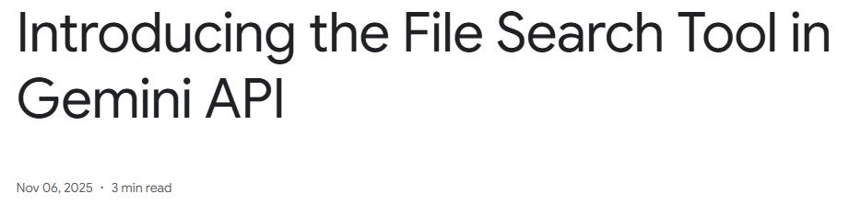
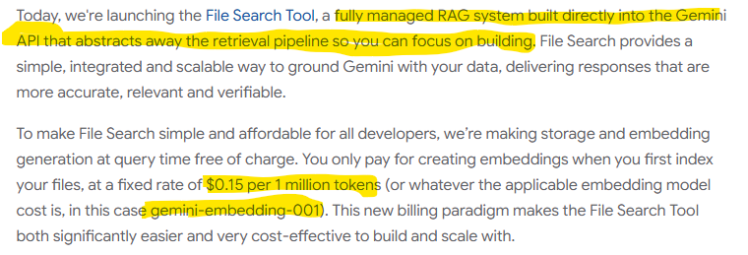

Slide 50
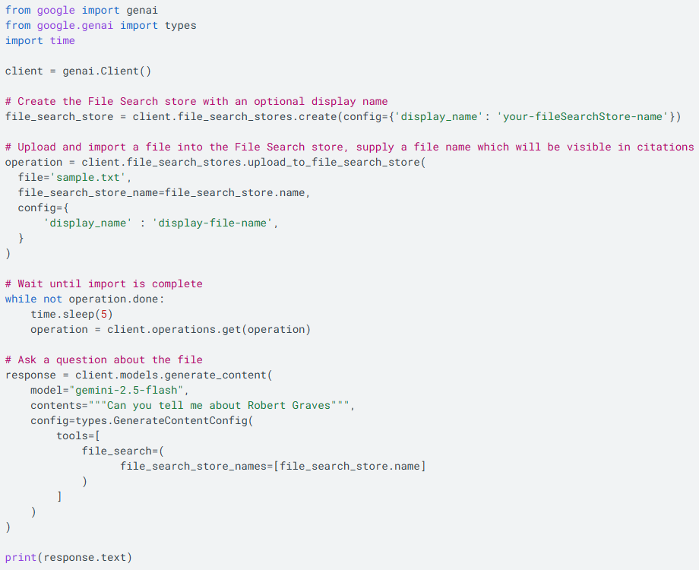

Slide 51
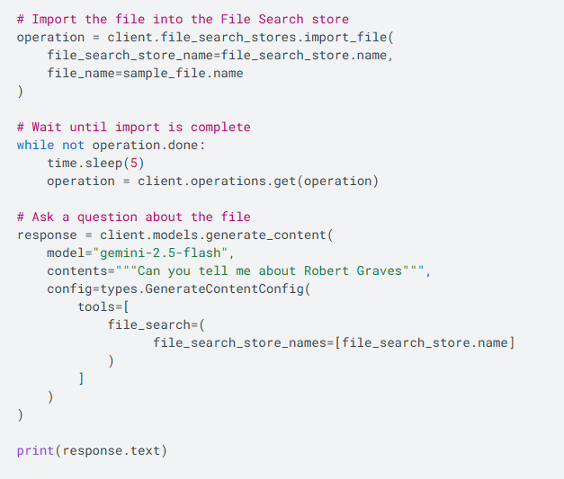

Slide 52
TOON (Token-Oriented Object Notation)

Slide 53
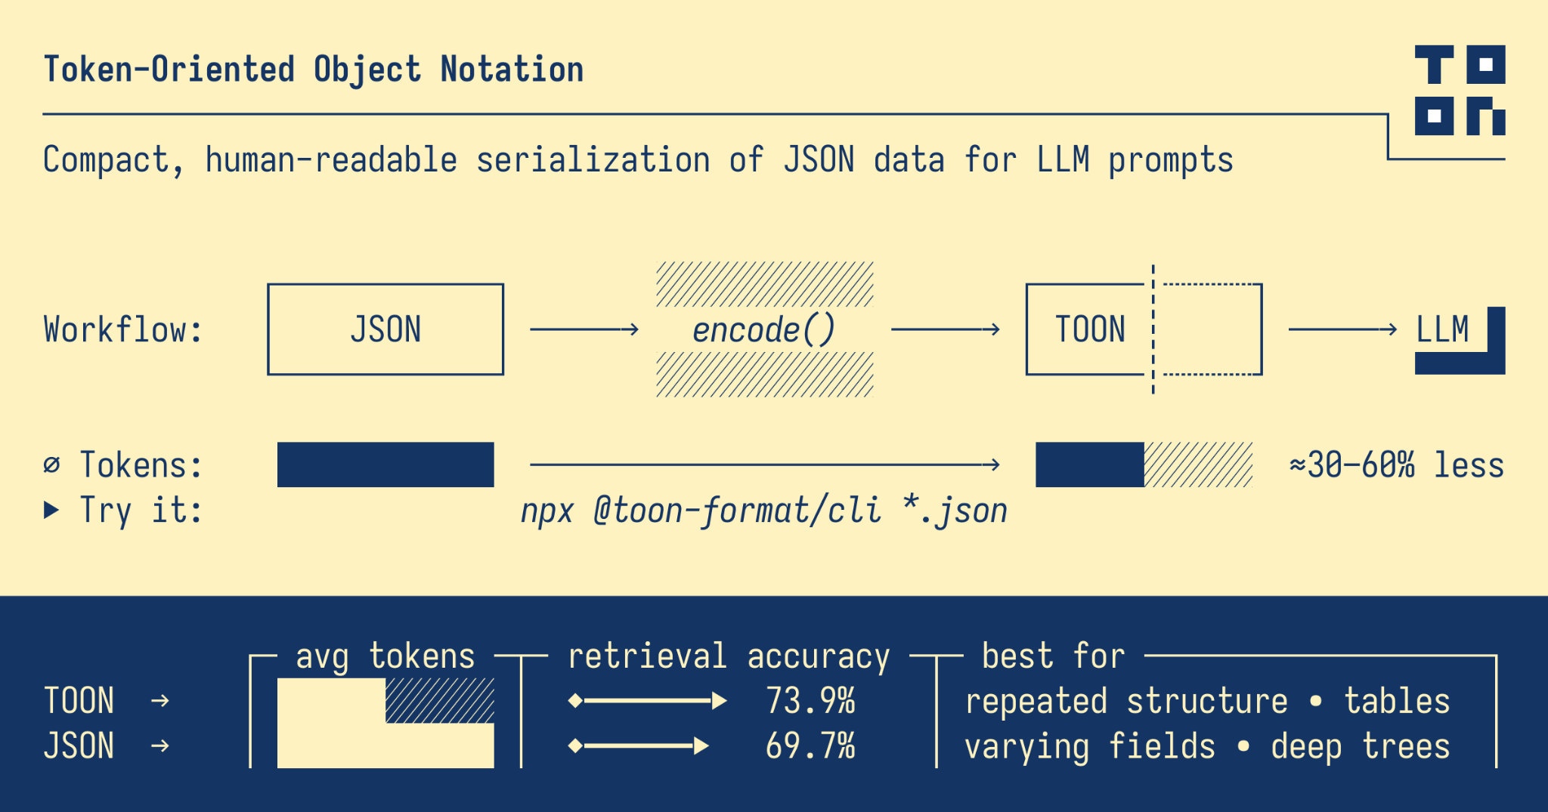
Reduce tokens with this new format

Slide 54
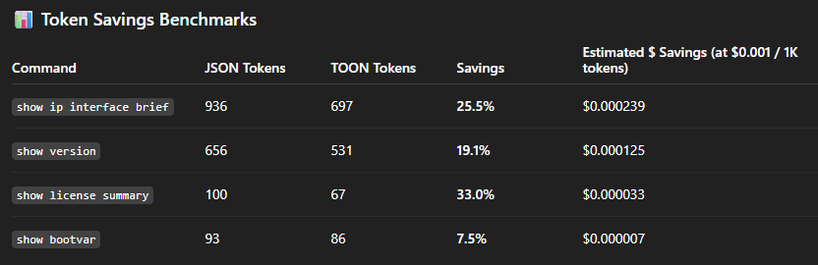
Personal testing results

Slide 55
RAG Lab Agenda
Lab One – Exploration
Embeddings
Splitting
Storage
Lab Three – Talk to Networks
Cisco pyATS
Cisco DevNet Always On Sandbox
Routing Table
6 Step process
JSON -> TOON
Lab Two – Talk to PDFs
Large Language Model
Embeddings Model
Source
Loader
Semantic Chunking
Storage
Retrieval
PDF Buddy
Lab Four – Talk to Networks
6 Step Process
Router Buddy

Slide 56
Labs: Getting started automateyournetwork/NAF_AC4_RAG: RAG Labs for NAF Autocon4
Cisco DevNet Always-On Sandbox
Cisco IOS-XE
Cisco pyATS
GitHub
Git
Python
Visual Studio Code (VS Code)
cURL
Postman (GUI)
LangChain
LangGraph
ChromaDB
Large Language Model – openAI ChatGPT4o
Embeddings Model – openAI Embeddings
Vectors
Semantic Chunking
Streamlit

Slide 57
VISIT:
automateyournetwork/NAF_AC4_RAG: RAG Labs for NAF Autocon4 Clone the repo Follow the README and Email you received

Slide 58
Model Context Protocol: Protocols In the Age of AI: A Cambrian Period of Innovation​

Slide 59
The impact of protocols
Remember or try to imagine society before ….
Simple Mail Transfer Protocol (SMTP)
Hyper-Text Transfer Protocol (HTTP)
Various routing protocols (RIPv2, OSPF, BGP)
E-mail clients
Web browsers
Static routing
E-mail servers
Web servers
Rise of the Internet

Slide 60
What is Model Context Protocol
The “USB-C” of AI
Say it backwards - it’s a protocol that provides context to models
Anthropic released MCP in late Nov 24
Client / Server Architecture
Since then over 16,000 MCP servers have been made available
MCP Servers offer tools
Embraced universally by Microsoft, Google, openAI, GitHub, AWS
MCP Client discover and can utilize tools
Added to the new CCNP: Automation track
MCP Server can be anything from a REST API, a database, a Python script
Natural Language is the foundation

Slide 61

Local Resource A
MCP Server A
MCP
Local Resource B
MCP Host (Claude, IDEs, Tools)
MCP Server B
MCP
MCP Server C
Web APIs
MCP
Internet
Remote Resource C

Slide 62
Client / Server: Server
Servers are quite easy to build using the FastMCP Python package
Servers can be run locally as stdio mode or remotely hosted such as Selector (remote, secure, streaming MCP)
from mcp.server.fastmcp import FastMCP
mcp = FastMCP("pyATS Network Automation Server")
@mcp.tool()
async def pyats_run_show_command()
mcp.run()

Slide 63
Client / Server: Clients
Many clients have emerged
AI Agents
Claude Desktop / Claude Code
Agents are often powered by MCP Tools the Agent can utilize
ReAct (Reasoning and Actions) Agents where the Actions equal MCP tool calling
Gemini-CLI
VS Code, Cursor, Tailwind (IDEs)
Agency to act without human intervention

Slide 64
Questions?

